Slide 1
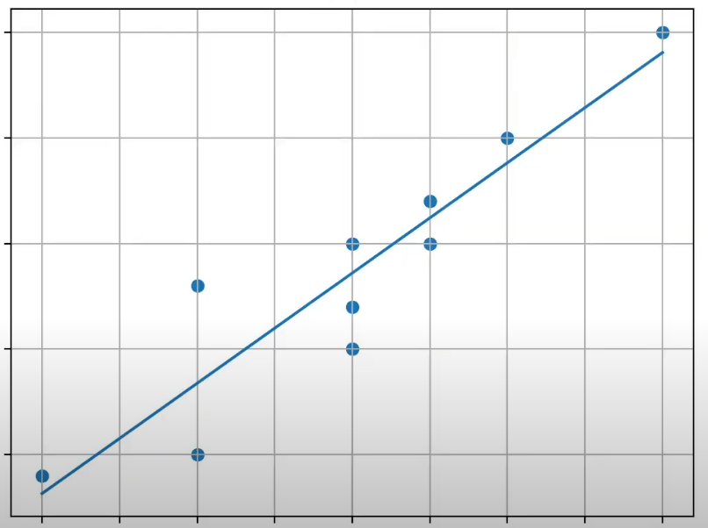
Contents
Machine Learning: Regression
[분류] Deep Learning w/ Backpropagation (Gradient Descent Method)
[추정] Linear Regression (선형회귀)
Simple Linear Regression (단순선형회귀)
Multiple Linear Regression (다중선형회귀)

Slide 2


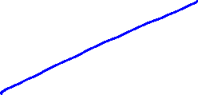
Linear Regression (보강)
Single Linear Regression
Multiple Linear Regression
Solution: OLS
(1) 해석학적 접근
(2) 대수적 접근
* Ordinary Least Squares (OLS) = Least Squares Method (LSM) = Normal Equation

Slide 3
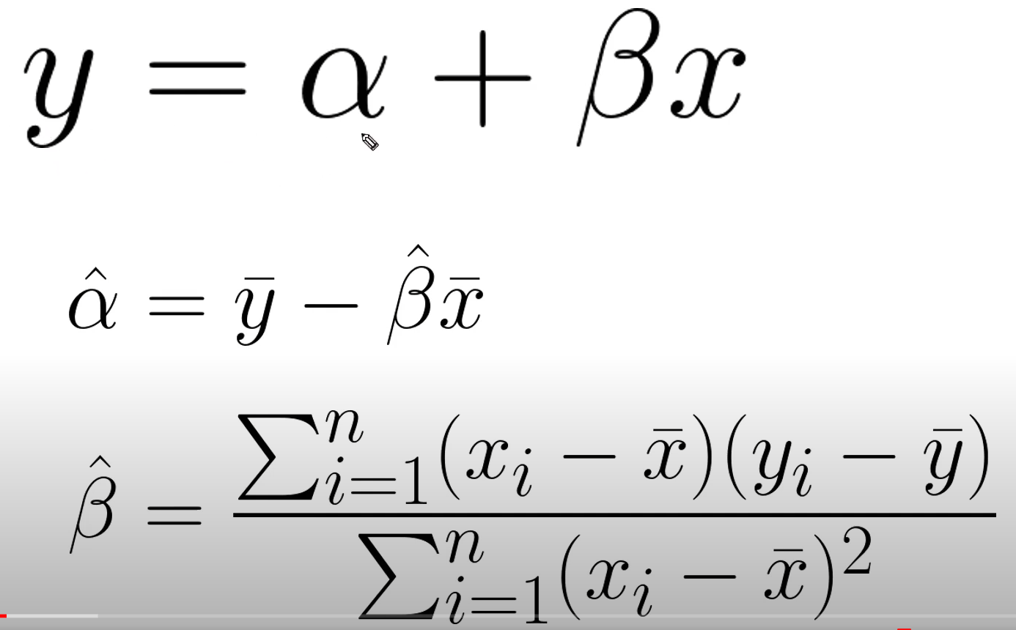

Slide 4
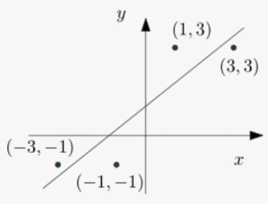

Slide 5





















Slide 6






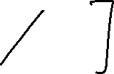













Slide 7
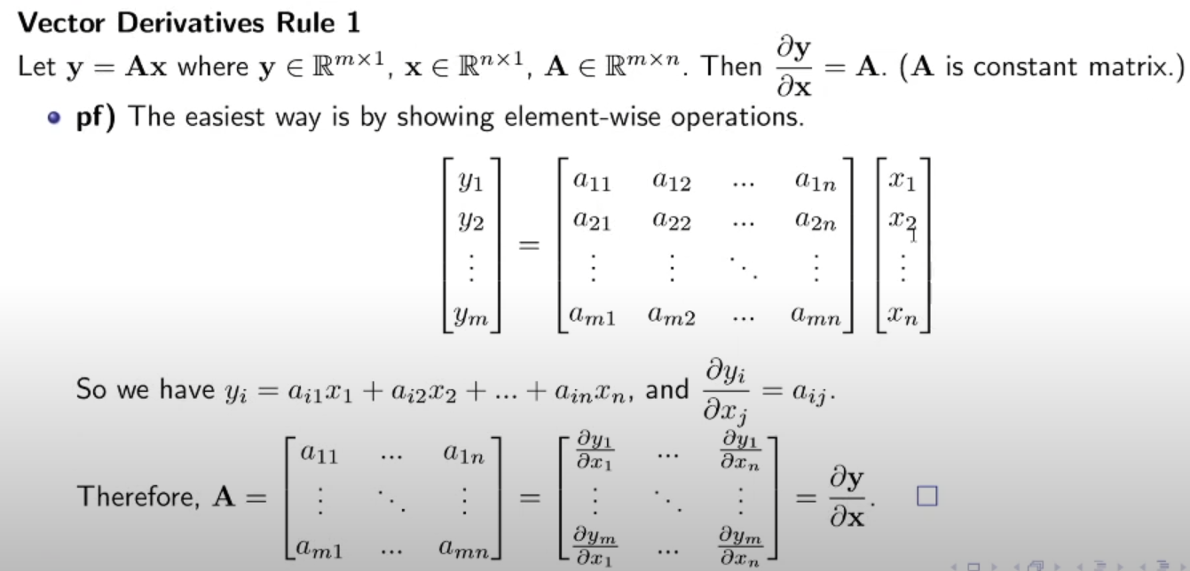
벡터/행렬 미분 (Vector/Matrix Derivative)

Slide 8
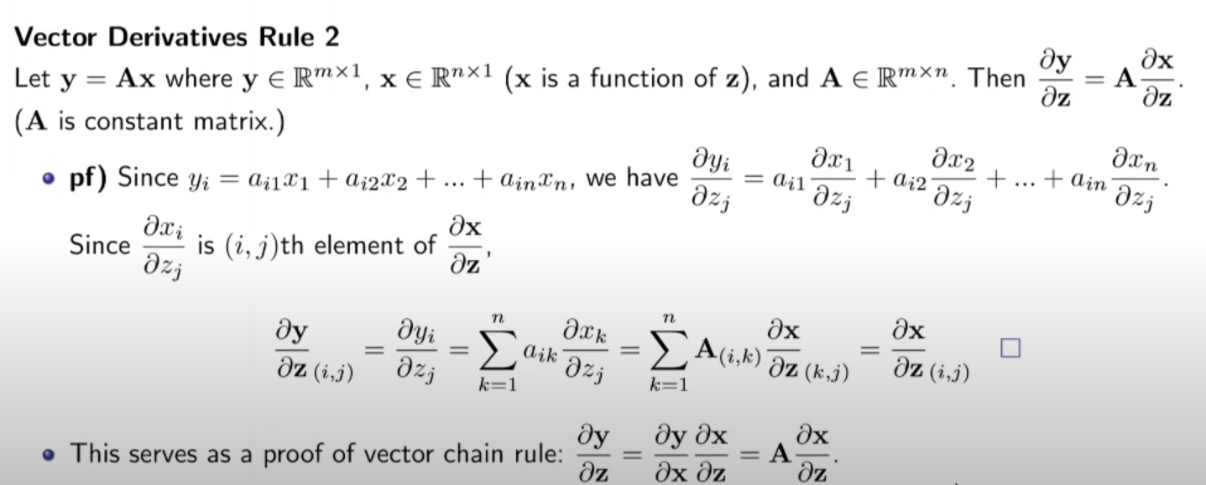
벡터/행렬 미분 (Vector/Matrix Derivative)

Slide 9
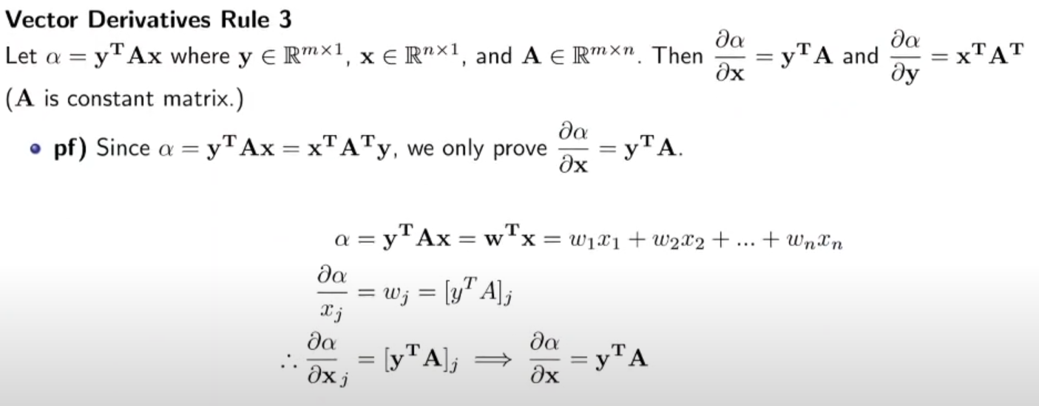
벡터/행렬 미분 (Vector/Matrix Derivative)

Slide 10
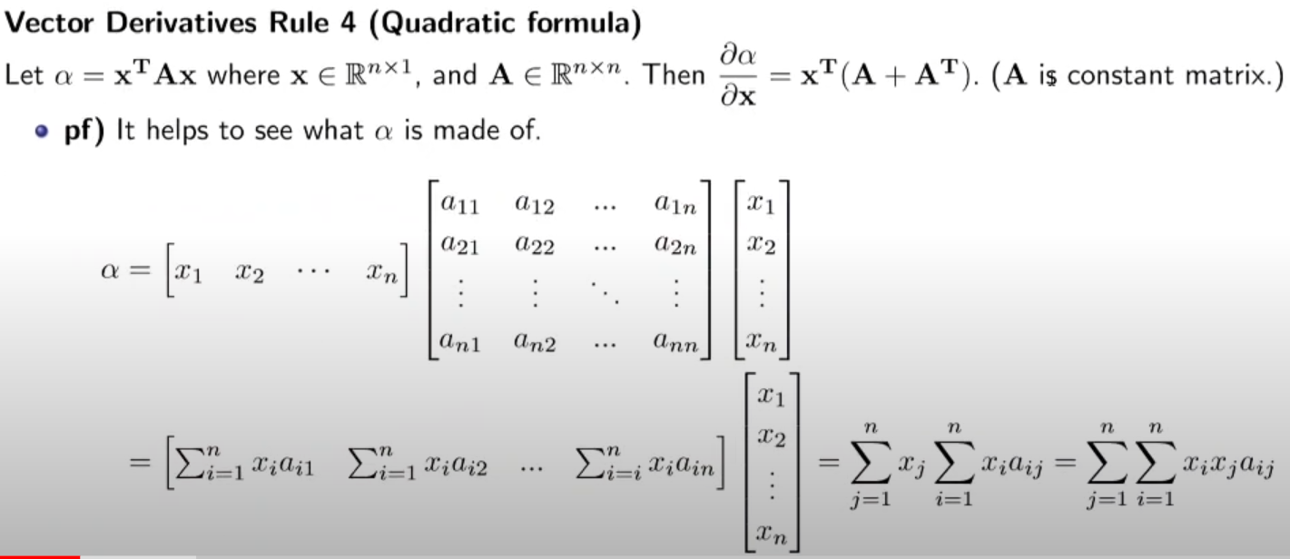
벡터/행렬 미분 (Vector/Matrix Derivative)

Slide 11








































































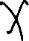


Slide 12



























Slide 13
Regression & L1/L2 Regularization
Linear Regression
Lasso Regression (L1 Regularization)
Ridge Regression (L2 Regularization)
Elastic Regression (L1&L2 Regularization)

Slide 14
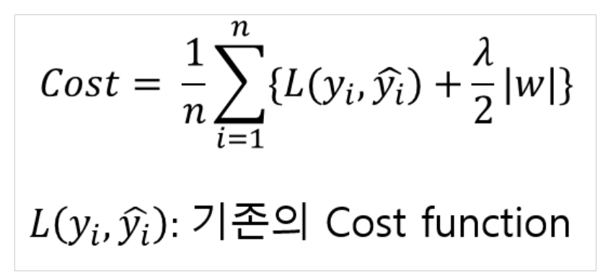
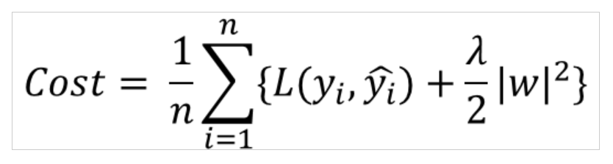
L1 Regularization vs. L2 Regularization
L1 Regularization
L2 Regularization

Slide 15
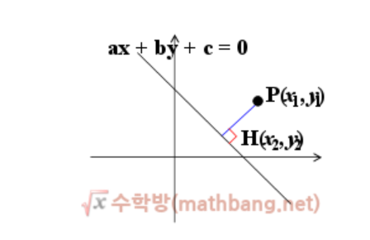
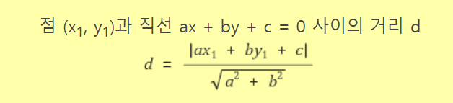


Slide 16













Slide 17




























Slide 18



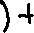



Slide 19













Slide 20














